Slide 1


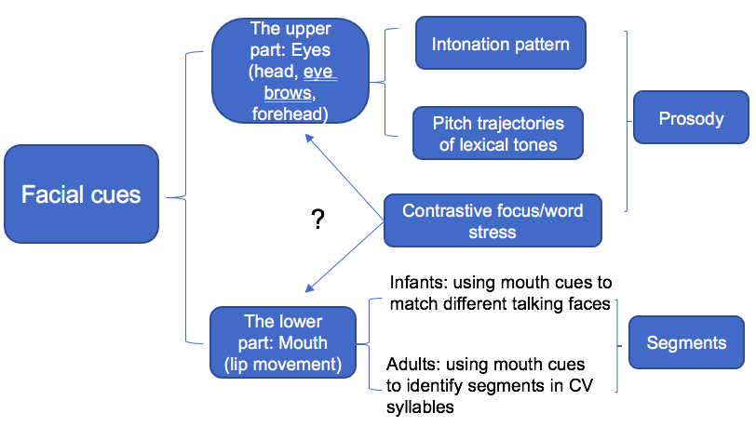
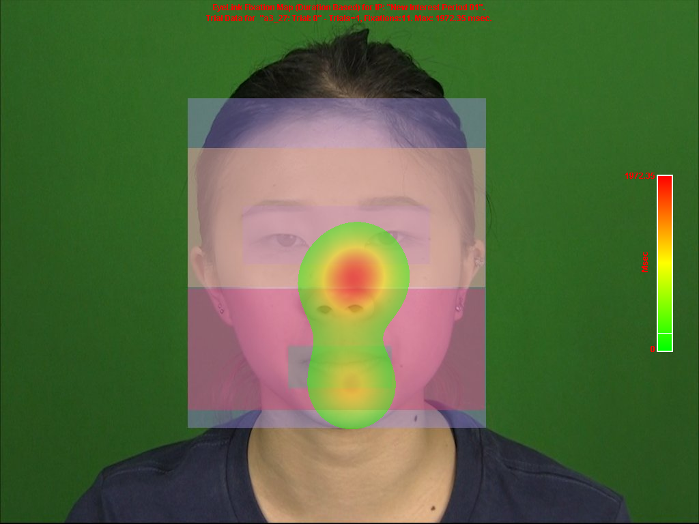
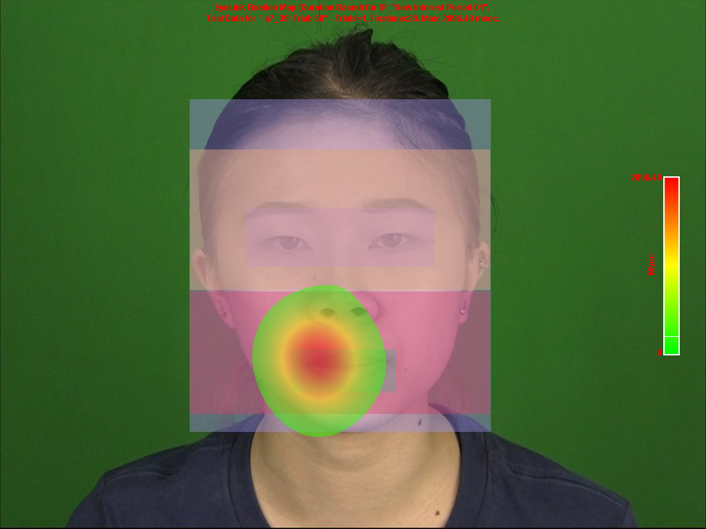
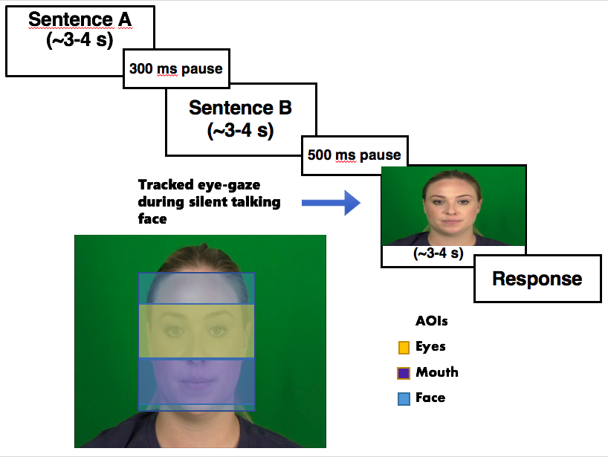
The perception of visual phonetic information: Eye-tracking while searching for segmental versus prosodic cues
Get
a logo!
Xizi Deng, Erin Jastrzebski, Elise McClay, H. Henny Yeung, Yue Wang
Simon Fraser University, Canada
Stimuli:
Participants
24 native speakers of Canadian English
19-30 years old (mean = 21.2, SD = 2.3)
Procedure:
Introduction
Method
Phrasal bracketing: critical information is concentrated with the first or second half of the sentences ➔ shift to the critical facial areas quickly depending on when the critical information starts
Intonation: prosody over the whole sentences & segments within the second half➔ more parallel looking to the critical facial areas
Visual cues can enhance auditory speech comprehensibility
Listeners use visual cues in particular facial areas to identify different types of speech
Word-level contrastive focus: raised pitch, elongated duration, etc. ➔ both eye-brow raising and chin & lip movement.
Sentence-level intonation: F0 variation ➔ eye-brow raising & head movement.
Word focus | Condition
No, JESS found her PLAIN dress for KYLA’S wedding. | Reference Sentence
No, Jess FOUND her plain DRESS for Kyla’s WEDDING. | Prosody
No, ANNE found her BLUE dress for JIMMY’S wedding. | Segments
No, Anne FOUND her blue DRESS for Jimmy’s WEDDING. | Both
Phrasal bracketing
Vanessa and [Alexander or Katrina] will pick up the popcorn. | Reference Sentence
[Vanessa and Alexander] or Katrina will pick up the popcorn. | Prosody
Christina and [Zachariah or Maria] will pick up the popcorn. | Segments
[Christina and Zachariah] or Maria will pick up the popcorn. | Both
Intonation
Sally will make a call [before the salon closes?] | Reference Sentence
Sally will make a call [before the salon closes.] | Prosody
Sally will make a call [after she finishes lunch?] | Segment
Sally will make a call [after she finishes lunch.] | Both
Plot A, Plot B and Plot C reflect raw Elog values and model fits (solid lines) in word-focus, phrasal bracketing and intonation type respectively.
Summary of results
Overall fixations to mouth (intercept): segments > prosody in all three prosodic types
Shift between mouth and eyes (quadratic, cubic and quartic terms):
Word focus: prosody > segments> both
Phrasal bracketing: segments= both > prosody
Intonation: both > segments > prosody
PowerPoint to PDF
Discussion
Segments v.s. prosody
A greater emphasis on looking to the mouth for segmental information.
Words v.s. phrases v.s. sentences
Looking patterns changed, along with visual prominence of cues and different distribution of critical information
Word-level:
Visual cues from both eyes and mouth were important for prosody
Cues overlapped in mouth for both prosody and segments: prioritized mouth for efficiency, because mouth carried more prominent cues for both
Phrase-level:
Attended to mouth quickly for segmental information and slowly for prosody when critical information was concentrated within a chunk
Sentence-level:
Intonation ➔ eyes; Segments ➔ mouth
Both information➔ both mouth and eyes because eyes carried more prominent cues for intonation
References:
[1]J. Navarra, H. H. Yeung, J. F. Werker, and S. Soto-Faraco, “24 Multisensory and sensorimotor interactions in speech perception,” The Handbook of Multisensory Processing., pp. 435, 2012.
[2] K. W. Grant and P.-F. Seitz, “The use of visible speech cues for improving auditory detection of spoken sentences,” J. Acoust. Soc. Am., vol. 108, no. 3, p. 1197, 2000.
[3] M. E. Król, “Auditory noise increases the allocation of attention to the mouth, and the eyes pay the price: An eye-tracking study,” PLoS One, vol. 13, no. 3, pp. 1–15, 2018.
[4] W. H. Sumby and I. Pollack, “Visual Contribution to Speech Intelligibility in Noise,” J. Acoust. Soc. Am., vol. 26, no. 2, pp. 212–215, 1954.
[5] E. Vatikiotis-Bateson, I. M. Eigsti, S. Yano, and K. G. Munhall, “Eye movement of perceivers during audiovisual speech perception,” Percept. Psychophys., vol. 60, no. 6, pp. 926–940, 1998.
[6] M. Dohen and H. Loevenbruck, “Interaction of Audition and Vision for the Perception of Prosodic Contrastive Focus,” Lang. Speech, vol. 52, no. 2–3, pp. 177–206, 2009.
[7] M. Swerts and E. Krahmer, “Facial expression and prosodic prominence: Effects of modality and facial area,” J. Phon., vol. 36, no. 2, pp. 219–238, 2008.
[8] C. R. Lansing and G. W. McConkie, “Word identification and eye fixation locations in visual and visual-plus-auditory presentations of spoken sentences,” Percept. Psychophys., vol. 65, no. 4, pp. 536–552, 2003.
[9] C. R. Lansing and G. W. McConkie, “Attention to Facial Regions in Segmental and Prosodic Visual Speech Perception Tasks,” J. Speech, Lang. Hear. Res., vol. 42, pp. 526–539, 1999.
[10] E. Cvejic, J. Kim, C. Davis, and G. Gibert, “Prosody for the eyes: Quantifying visual prosody using guided principal component analysis,” Proc. 11th Annu. Conf. Int. Speech Commun. Assoc. INTERSPEECH 2010, no. September, pp. 1433–1436, 2010.
[11] J. M. Foxton, L. D. Riviere, and P. Barone, “Cross-modal facilitation in speech prosody,” Cognition, vol. 115, no. 1, pp. 71–78, 2010.
[12] K. G. Munhall, J. A. Jones, D. E. Callan, T. Kuratate, and E. Vatikiotis-Bateson, “Visual Prosody and Speech Intelligibility: Head Movement Improves Auditory Speech Perception,” Psychol. Sci., vol. 15, no. 2, pp. 133–137, 2004.
[13] S. Garg, G. Hamarneh, A. Jongman, J. A. Sereno, and Y. Wang, “Computer-vision analysis reveals facial movements made during Mandarin tone production align with pitch trajectories,” Speech Commun., vol. 113, no. April, pp. 47–62, 2019.
[14] R. E. Ronquest, S. V. Levi, and D. B. Pisoni, “Language identification from visual-only speech signals,” Attention, Perception and Psychophysics, vol. 72, no. 6, pp. 1601–1613, 2010.
[15] P. Prieto, C. Puglesi, J. Borràs-Comes, E. Arroyo, and J. Blat, “Exploring the contribution of prosody and gesture to the perception of focus using an animated agent,” J. Phon., vol. 49, pp. 41–54, 2015.
[16] L. G. Lusk and A. D. Mitchel, “Differential Gaze Patterns on Eyes and Mouth During Audiovisual Speech Segmentation,” Front. Psychol., vol. 7, no. February, pp. 1–11, 2016.
[17] D. J. Lewkowicz, M. Schmuckler, and V. Agrawal, “The multisensory cocktail party problem in adults: Perceptual segregation of talking faces on the basis of audiovisual temporal synchrony,” Cognition, vol. 214, no. September, pp. 104743, 2021.
[18] C. Cavé et al., “About the Relationship between Eyebrow Movements and F0 Variations,” Proceeding Fourth Int. Conf. Spok. Lang. Process., vol. 4, pp. 2175–2178, 1996.
[19] R. Scarborough, P. Keating, S. L. Mattys, T. Cho, and A. Alwan, “Optical Phonetics and Visual Perception of Lexical and Phrasal Stress in English,” Lang. Speech, vol. 52, no. 2–3, pp. 135–175, 2009.
[20] M. Dohen, H. Loevenbruck, M. Cathiard, and J. Schwartz, “Can we see Focus ? A Visual Perception Study of Contrastive Focus in French,” Speech Prosody 2004, International Conference, 2004.
[21] J. W. Dink and B. Ferguson, “Eyetracking R: An R Library for Eye-Tracking Data Analysis.,” 2015. URL http://www.eyetrackingr.com
[22] D. Mirman, J. A. Dixon, and J. S. Magnuson, “Statistical and computational models of the visual world paradigm: Growth curves and individual differences,” J. Mem. Lang., vol. 59, no. 4, pp. 475–494, 2008.
[23] S. Kalénine, D. Mirman, E. L. Middleton, and L. J. Buxbaum, “Temporal dynamics of activation of thematic and functional knowledge during conceptual processing of manipulable artifacts,” J. Exp. Psychol. Learn. Mem. Cogn., vol. 38, no. 5, pp. 1274–1295, 2012.
A. More looking to the upper part
B. More looking to the lower part
The current study
Gap in previous studies
Research has not been conclusive as to how a face is scanned for different. types of prosodic information: local word level, phrase level, global sentence level.
How looking patterns differ for prosody and segments.
The current focus
The overall scanning dynamics when processing segments versus three types of prosodic information:
Contrastive word focus (more local)
Sentence intonation (more global)
Phrasal bracketing (intermediately)
How perceivers adjusted their scanning strategies as task difficulty increased across conditions by varying the concordance of prosodic and segmental information.
Hypotheses
Overall fixations: Segments: mouth > eyes; Prosody: mouth < eyes
Gaze shift between mouth and eyes: word stress > phrasal bracketing > intonation
Results
Analysis: three growth curve analyses on the three prosodic types
Fixed factor: the 3 conditions (segments, prosody, both)
Dependent variable: Fixation proportions
Random factors: subject, item
Fourth-order polynomial terms:
Intercept: overall fixation proportions
Quadratic, cubic and quartic terms: steepness of curves around the inflection points at the extremities ➔ shift between mouth and eyes
General looking patterns
Looking to the mouth – eyes---mouth---eyes
Word focus: critical information is more diffused ➔ stopped searching after the first differentiating word
Where to Print Display-Sized Poster

